Slide 1


Slide 2
Business/Entity Structures
The most commonly used are:
S-Corporation
C-Corporation
Limited Partnerships (LP)
Limited Liability Companies (LLC)

Slide 3
C Corporation
Stand alone entity
Pay taxes on income they generate
Biggest downside is double taxation
First taxed on corporate level
Then taxed on individual level when distributed to shareholders
Any rental income not dispersed regularly
subject to 15% personal holding company
(PHC) tax
C
Corp

Slide 4
S Corporation
Not subject to double-taxation
Profit and losses pass through to shareholders
Major benefit is that shareholders can be employees and receive a salary
Any profit above reasonable salary can be paid as bonuses or distributive shares
Distributive shares are not
subject to Social Security and
Medicare taxes
S
Corp

Slide 5
Limited Liability Company
Easy to form in all 50 states
Provides same liability protection as a corporation
Single-level taxation
Often referred to as a combination of partnership and corporation
Very easy to manage and run
Don’t need annual meeting
Most commonly used in real estate
investing
LLC

Slide 6
LLC’s Continued
Upon formation Operating Agreement is created
Who manages, and how
Each members name
Amount of ownership held by each member
Another benefit is profits, losses, and tax benefits can be allocated anyway you like

Slide 7

Business/Entity Structure Tips
Keep personal finances separate
You want an umbrella liability policy
You also want to keep each property in a separate LLC
Make sure each LLC has a separate bank account or at the least ledgered separately

Slide 8

Business/Entity Structure Tips
Creating a holding company
Setting up a management company
  Only manage your own properties
  If you manage someone else’s you need to be a licensed real estate broker
Create a construction company

Slide 9
Joint Venture Example
Your Holding Company LLC
Investor LLC
Investor LLC
Investor LLC
Investor LLC
Property Specific LLC
Property Specific LLC
Property
Property

Slide 10
TYPICAL JV STRUCTURE
(NON-SYNDICATED DEALS)
JV Partner A
JV Partner B
JV Partner C
This would be your S-Corp holding company
No one is passive, everyone has a role in the deal
Partnership Operating LLC
Usually formed in DE, WY, or
NV – LLC taxed as partnership
Property Specific LLC
Usually formed in State
where the property is located

Slide 11
Syndication Example
ETC
Sponsor Partner
2 LLC
Sponsor Partner
1 LLC
Your Holding
Company LLC
Sponsor Group
LLC
Equity
Class A
Management
Class B
Main Operating
Equity LLC
Usually Formed in DE, NV, WY
PSE
Property Specific
Equity LLC
Formed in State where property is located
A/C/A
Borrowing Equity
Property

Slide 13

Hiring A Property Management Company

Slide 14
Initial Property Management
Call Script
Hello
I’m a multifamily investor. I live in _______but we’ve targeted ______ to buy in. I’ll be visiting later this month and I wanted to set some appts with property management companies for while I’m there. Do you mind if I ask you some questions? Tell me a little about your company. What size properties do you manage? What asset class? We buy value add A, B and C properties in A, B and C areas. The size we like is ___ to _____units. Can you give me your thoughts about investing in _____? Are there areas you like more than others? Any areas gentrifying? Are there any major employers moving in or out? Wo are the best brokers for the size and type of properties we like? Can you make an introduction?

Slide 15

Hiring a Property
Management Company
Make sure:
  They have office in area of your property
  They don’t own or have ownership interest in any nearby properties
Look for a company who manages similar size and types of your property
A firm who manages all 100 unit and up buildings may struggle with your 10 unit

Slide 16

Hiring a Property Management Company
If you’re hiring them right from the start they can aid in due diligence
  Mystery shop the property management company
  Go through the rental process and see how professional they are

Slide 17

Hiring a Property Management Company: What
They Should Do
Determine market rents
Rent collections
Locating and screening tenants
Writing leases
Evictions and move-outs
Maintenance and repairs
Payment and expenses
Financial reports and summaries

Slide 18
Property Management Company Tips
Set a maximum expense threshold:
Anything under it and they can spend
Anything over and they need to reach you
Stay in regular communication and ask lots of questions
Be a signer on all accounts
Always get three bids on larger repairs
Pay bonuses for renewals and exceeding net revenue forecasts
Make surprise visits and walk units
Get list of any payables at the end of every month
Always check your management fee charges on your statements

Slide 19

Hiring a Property Management Company
Questions you should ask:
Renting the Property:
  What is their procedure?
  What mediums do they use to advertise a rental?
  What is their average turn-around-time?

Slide 20
Hiring a Property Management Company
Screening Tenants:
  Do they personally interview the applicants?
  What screening steps do they use?
  Do they have a standard lease agreement? If so get a copy
  Who designed the lease agreement? Hopefully an attorney
  When was it last updated?
  Do they explain the lease and their procedures verbally to the tenant at lease up?

Slide 21
Hiring a Property Management Co.
Maintenance and Repairs:
How do they deal with these issues?
When do they contact the owner for authorization?
Who do they use to complete repairs?
Are they licensed?
Are their maintenance staff employed by their company or are they a subcontractor?
What is their hourly rate for each type of work?
Do they conduct periodic inspections? When?
How do they handle an emergency repair?

Slide 22
Rent Collections and Delinquencies
What are their procedures regarding monthly rental payments?
What do they do if the tenants are late?
How long do they wait until filing for eviction?
How do they determine fair market rent for a unit?
How do they determine when to increase the rent?

Slide 23
Reporting and Communication
Reporting:
How regularly do they report on rental collections?
Should you expect monthly or quarterly statements?
Communication:
How often do they contact property owners?
What method do they use to contact? Email, text, phone calls?

Slide 24
Hiring a Property
Management Company
You should receive the following reports on a monthly basis:
Income statement
Expense statement
Current rent roll
List of all vacancies
List of all delinquencies
Annual budget
Narrative of what's happening with operations
You may request that they do a quarterly market survey of your competitors

Slide 25

Taking Over a Property Yourself
After closing there’s a lot you want to do to ensure that things go smoothly
Residents may be worried/scared of new ownership

Slide 26
Taking Over Management Yourself
Upon acquisition you want to notify tenants that you are new owner
Prepare a letter and put on each door
The letter should include:
  Name, address, and phone number of new owner AND property management company (if applicable)
  How the rent can be paid – online, bank draft, check, etc.
  Where to mail the rent
  Where and how to contact for maintenance and other issues
  Who to contact in case of emergency

Slide 27
Update Tenant Information
In the letter you should include a way for tenants to update their information for you
Could be paper form, link on website, or email address to respond to
They should update/confirm their:
  Name, age, and relationship of all residents
  Contact information
  Current employer information including phone number in case of emergency

Slide 28


Notify & Contact:
Utility companies
  They will want to know the new owner’s address
The local fire and police department
  Give them your contact info and your property managers contact info

Slide 29

Contact All Current Vendors
Update/rewrite any contracts
Some of the examples:
  Swimming pool
  Parking lot maintenance
  Landscapers/lawn maintenance
  HVAC
  Plumbers
  Electricians
  Pest control
  Vending machine
  Washer/ dryer equipment owners

Slide 30

Set Up Property-Specific Checking Account
Make sure property specific account is in name of entity listed on title
Always keep your personal finances and the property’s finances separate

Slide 31

Set Up Accounting System
Speak with your accountant upon your new acquisition
Most often expenses are misclassified
Learn the difference between an expense and capital improvement
Cash or accrual method of accounting?
Determine depreciation schedule and decide on cost segregation

Slide 32

Implement a Purchase
Order System when you get larger
“If they do work without a PO, they may not get paid”
Implement payment/check cycle
  30 day terms
Manual Page 144

Slide 33

Create Management Systems
Ensure you and your onsite property manager have systems in place for the following:
Rent collections
Late pay procedure
Maintenance systems and procedures
Property upkeep, scheduled maintenance
      Marketing systems
      Purchase order system
      Lease up procedures
      Accounting procedures

Slide 34

Hiring an Onsite Manager
Self management doesn't necessarily mean you have to collect rents, fix toilets, and lease units
Self management means you don’t hire an offsite property management company
Instead, you hire your own personnel

Slide 35

Hiring an Onsite Manager
Onsite manager
Depending on the workload and size of your property
  They can be full-time or part-time
  They can just get a rent discount
  They can get free rent and nothing else
  Or free rent and compensation

Slide 36

Hiring an Onsite Manager
12 unit property
  Manager gets $200 - $300 a month off rent
24-30 unit property
  Manager gets free rent (renewal bonuses)
40-50 unit property
  Manager gets free rent, renewal bonuses and $____ monthly salary

Slide 37

Hiring an Onsite Manager
They become “face” of your property
  They are your 24/7 eyes and ears
  They give you peace of mind
Their responsibilities can include:
  Show units
  Interact with current residents
  Interact with contractors
    Let them in, set times, etc.
  Answer property phone

Slide 38

Hiring an Onsite Manager
Deliver notices to tenants
Check and clean laundry room, mail center, common areas, etc.
Mow grass/keep tidy (optional)
Blow snow
Make ready
  Paint
  Minor maintenance
  Cleaning

Slide 39

Knowing the Law
Every state has different landlord/tenant laws, and even some cities do
Some of these laws are not very landlord friendly
Be aware of rent control
  Max rent
  How quick you can raise rent
  How much you can raise rent

Slide 40

Knowing the Law
Be aware of eviction laws
  Some locations it can take up to a year
Never turn off their electric/water, and/or change the locks when they’re gone, etc.
Cash for keys

Slide 41

Know What Constitutes Discrimination
National Origin
Sex
Race or Religion
Source of Income
Age
Marital Status
Familial Status
Disability
Sexual Orientation

Slide 42

Legal Reasons you can Reject an Application
Income is insufficient
They have negative references
They have poor credit
They have a criminal record
They lied on the application or did not fully fill it out
Can’t afford the payments
They have pets and you don’t allow
Lawsuits from previous landlords
Prior evictions on their record

Slide 43

Some High Level Tenant Rules
They must pay their rent timely
Must keep unit and surroundings clean
Must not disturb neighbors or break the law

Slide 44
What They Can Expect
From Me:
A safe place to live
A clean place to live
Legitimate maintenance requests will be handled timely

Slide 45
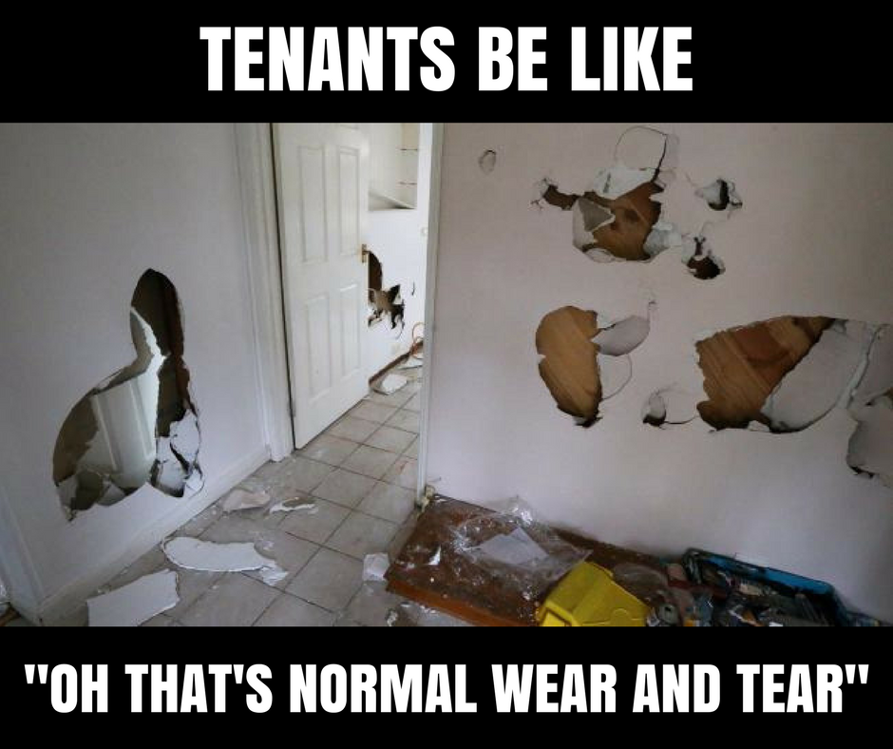

Slide 46
Important Self Management Tips
Always certified funds for first payment of rent and deposit and other intial fees
Keys only given when everything is done….
Lease is signed,
All certified funds received
Condition report signed
Tenant turnover is your biggest expense
Take care of your residents. If they have legitimate repair fix immediatelyand follow up
If they caused the damage make sure they pay you immediately
Treat them like someone you care about so they stay

