Slide 1

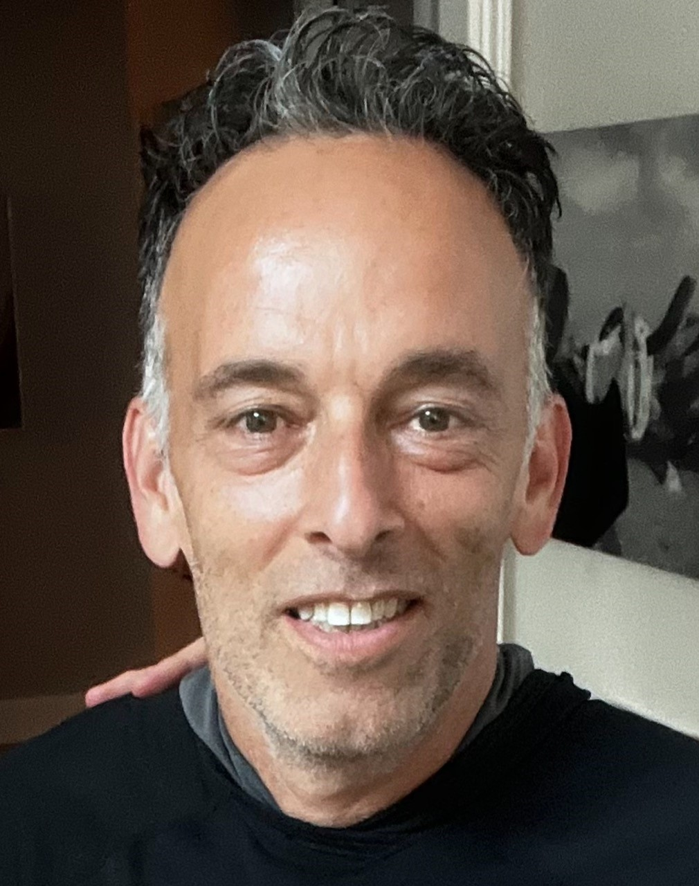



CONNECT WITH US
PHONE NUMBER:
(469) 398-2780
EMAIL ADDRESS:
TEAM@KALISERLAW.COM
WEBSITE:
WWW.KALISERLAW.COM
Remy Marsh

Slide 2



MERRILL KALISER, JD (1999)- mkaliser@kaliserlaw.com
Legal Expertise:
Former Corporate Bankruptcy and Restructuring Attorney for 8 years,
then Commercial Real Estate, Corporate and SEC Attorney for the last 17 years. My firm represents 250+ real estate transactions and syndications annually. We also provide workout and loan modification assistance with sponsors across the country.
Real Estate Experience:
Bought, renovated, property managed and sold 9,500+ SFRs GP on 7,900+ multifamily Units ($1B AUM)
GP on 5 Multifamily Development projects (3,400+ Units)
GP on 13 Car Wash Development projects (6 cities)

Slide 3


LOTS OF TOPICS
PARNTERSHIPS
MOUs
KEY PERSON/GUARANTOR
TIER II FINDER’S FEE AGREEMENT
THINGS TO THINK ABOUT AS AN ASSET MANAGER (CYA)
Q & A

Slide 4
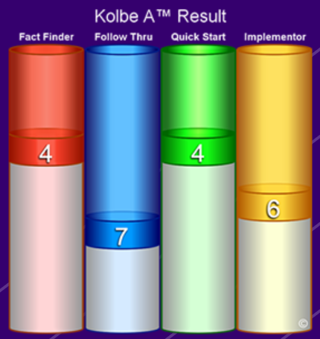
PARTERNSHIPS
Until death do us part? NOT, LIKELY!
Just like the divorce rate, dissolution of partnerships is >50% ⬆️
Kolbe Test (or other similar “strengths” tests)
“Date First”
Utilize MOUs (Memorandum of Understanding) FIRST!
Choose your partner like you would choose your spouse….Unless you are divorced 🤑🤑🤑

Slide 5
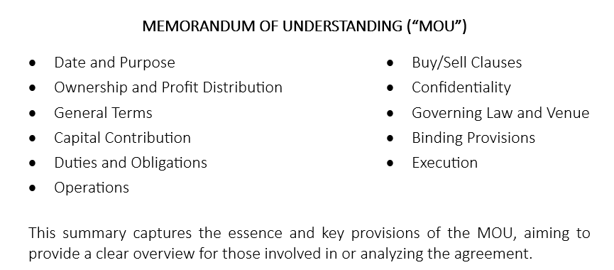
CAN I PAY SOMEONE TO BRING IN CAPITAL?

Slide 6
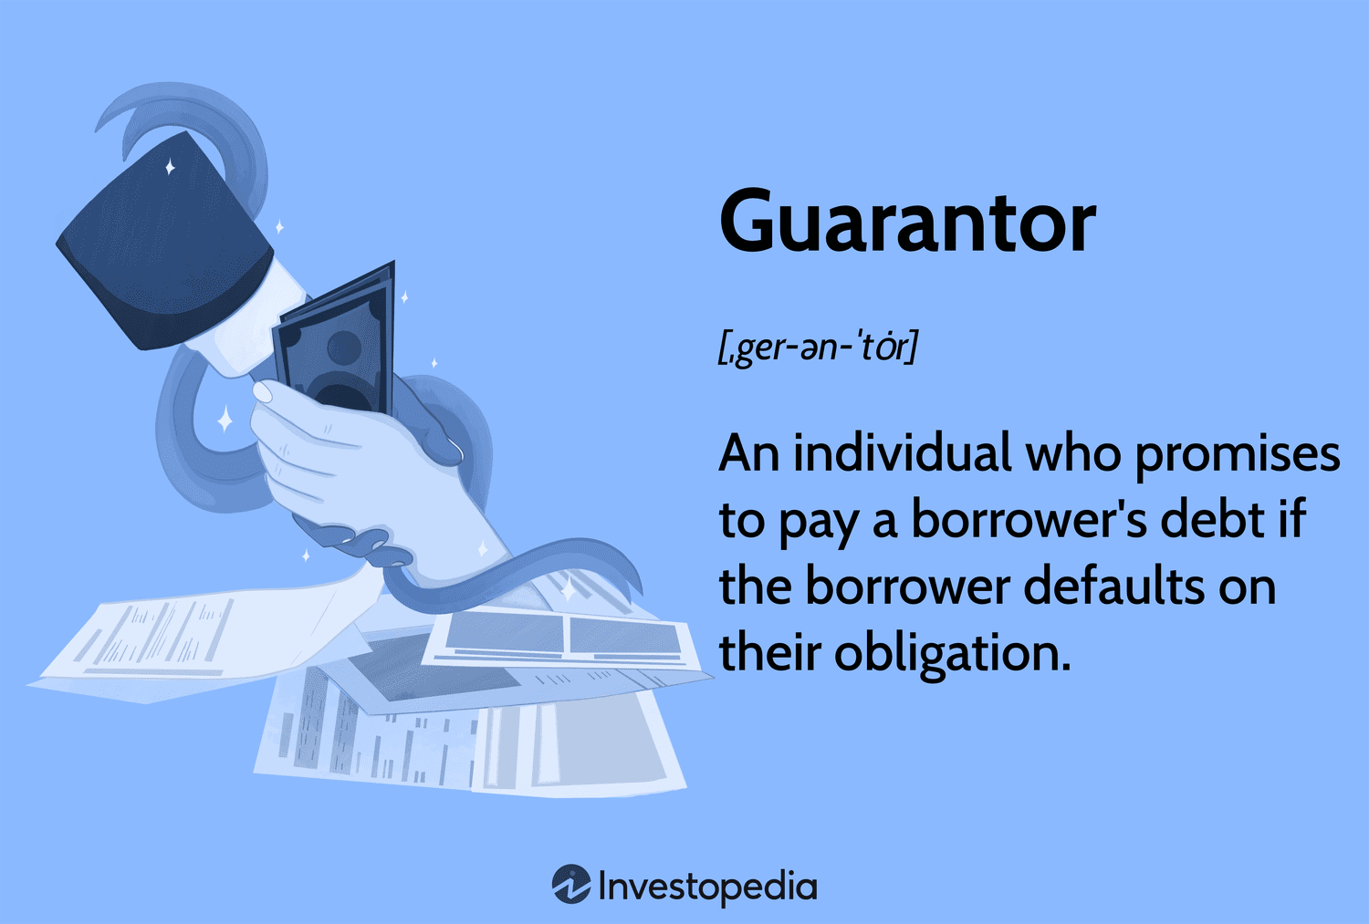
KEY PERSONS/GUARANTORS

Slide 7

UNDERSTANDING THE ROLE OF A “KEY PERSON” IN SYNDICATION AND LENDING
Financial Expectations and Responsibilities
December 2024
7

Slide 8

DEFINITION OF A “KEY PERSON”
An individual critical to the success of a syndication or sponsorship deal, often a principal or lead sponsor (but not necessarily).
Ensures the operational and financial execution of a project (but not necessarily.)
Represents credibility, experience and financial stability.
December 2024
8

Slide 9
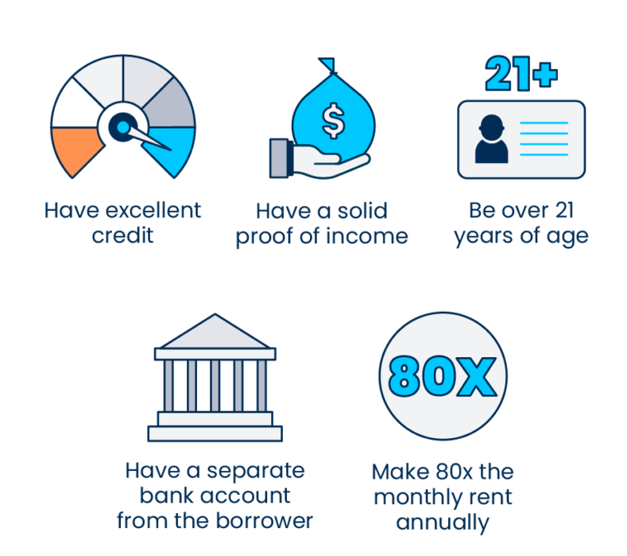
SYNDICATORS/SPONSOR PROSPECTIVE
What Syndicators/Sponsors Look for:
Track Record: Proven success in similar investments or projects
Equity Contribution: Significant financial investment to demonstrate commitment
Financial Net Worth: High personal net worth to secure loans and mitigate risk
Liquidity: Readily available cash or liquid assets to handle unforeseen expenses
Management Skills: Ability to lead, negotiate, and execute the project
December 2024
9

Slide 10
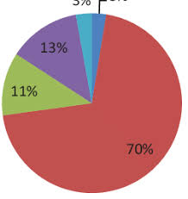
KEY PERSON’S FINANCIAL ROLE IN SYNDICATION
Equity Requirements:
Often required to contribute a % of the total equity (not necessarily)
Shows alignment with investor interests
Guarantees:
Personally guaranteeing portions of debt (recourse loans)
Helps secure favorable financing terms
Risk Mitigation:
Acts as a buffer for unexpected financial losses
December 2024
10

Slide 11
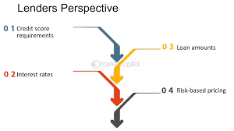
LENDER’S PERSPECTIVE ON A “KEY PERSON”
Financial Viability Metrics:
Creditworthiness: Strong credit score and history
Net Worth: Typically, a multiple or % of the loan amount
Liquidity: Sufficient liquid assets, often a percentage of the loan value
Experience:
Previous experience managing similar projects
Reputation:
Good standing in the industry with references or endorsements
December 2024
11

Slide 12
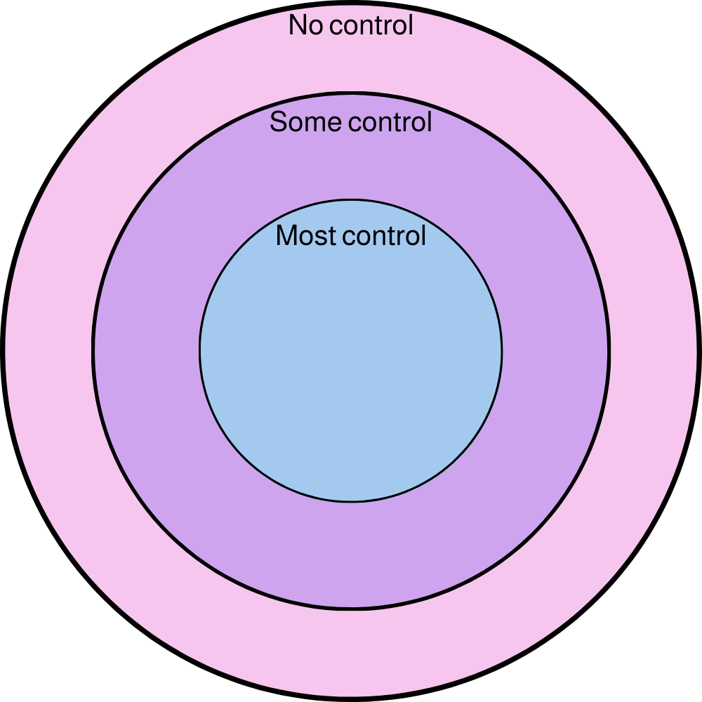
CONTROL VS. NO CONTROL MEASURES
Control Measures:
Key person may have direct control over project management and financial decisions
Lenders favor key persons with decision-making authority to ensure accountability
No Control Measures:
In some cases, key person’s role is limited to financial guarantees without operational control
Protects lenders in cases where the borrow defaults or needs restructuring.
December 2024
12

Slide 13
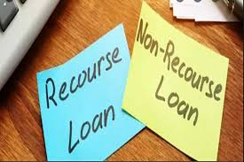
KEY PERSON GUARANTEES
Recourse Loans:
Key person provides a personal guarantee, increasing lender confidence
Non-Recourse Loans:
Lender focuses on property value but may require a key person’s guarantee for carve-outs
Bad-Boy Guarantees:
Key person ensures against fraud, mismanagement, or violations of loan terms.
December 2024
13

Slide 14

SUMMARY
Key Takeaways
Syndicators seek financial robust individuals with leadership and experience.
Lenders focus on net worth, liquidity, and creditworthiness of the key person
Final Thought:
The “Key Person” role is critical to bridging trust between sponsors, lenders and equity.
December 2024
14

Slide 15

QUESTIONS & DISCUSSIONS
What additional qualities do you think are critical for a “key person” to ensure project success?
What do you think a “key person” should be compensated and how?
What do you think a “key person” should be compensated and how?
Open up for additional questions?
December 2024
15

Slide 16

FINDERS = $$$$ (MAYBE)

Slide 17
“FINDER’S FEES” ARE PERMISSIBLE BY THE SEC TO FINDERS THAT ARE NEITHER BROKER/DEALERS NOR REGISTERED INVESTMENT ADVISORS

Slide 18
TWO TIERS OF FINDERS
Tier I Finders
Services Allowed:
🔗 Introduction Only: They can provide a list of potential investors and make introductions but can’t engage further.
🚫 No Transaction Participation: No involvement in discussions, negotiations, or advice on investment terms.
🙅‍♂️ No Further Contact: After the introduction, they cannot contact investors about the investment.
Tier II Finders
Services Allowed:
🔍 Introduction and Solicitation: Can actively solicit and contact potential investors, distribute issuer info, and discuss the issuer (but no investment advice).
🚫 No Investment Advice: Cannot advise on investment merits or recommend securities purchases.
💵 No Handling of Funds: Cannot handle funds or securities in transactions.

Slide 19
PAYMENT STRUCTURE FOR THE TIERS
Tier I Finders
Payment Structure:
💰 Fixed Compensation: They receive a fixed fee not tied to the investment’s outcome.
🚫 Non-Transaction Based: No transaction-based compensation, keeping them out of broker-dealer classification.
Tier II Finders
Payment Structure:
💸 Transaction-Based Compensation: Allowed to receive compensation based on transaction success, such as a percentage of funds raised.
📜 Disclosure Requirements: Must disclose their role, compensation nature, and conflicts of interest to investors, who must acknowledge this in writing.

Slide 20
ADDITIONAL ISSUES TO BE AWARE OF:
Conditions for Both Tiers:
🏢 Issuers: Only work with non-public companies.
💼 Accredited Investors: Can solicit only accredited investors.
📜 Transaction Scope: Must comply with private offering exemptions under Regulation D.
Prohibited Activities:
🚫 No Advice or Recommendations: Cannot provide investment advice.
🚫 No Authority: No authority to bind issuers or investors.
🚫 No Handling of Securities: Cannot handle customer funds or securities.
Compliance and Regulatory Oversight
📚 Record-Keeping: Must keep accurate records of activities and communications.
✔️ Exemptive Order Conditions: Must comply with SEC’s exemptive order conditions to be exempt from broker-dealer registration.

Slide 21
CYA – ASSET MANAGEMENT
Be TRANSPARENT! 👀👀
Communicate with your investors at least monthly (keep all correspondence)
Provide “commentary,” not just financials (include pics too)
Use a CRM program that allows you to track when an investor opens an update (if not opened, make sure they read or have opened it.
If you need a loan modification and/or capital call, err on communicating early (webinar is best)
Don’t be afraid to reach out to consultants for help!

Slide 22
Q & A
When are you going to get advice without paying for it?
No question is a dumb question?

Slide 23


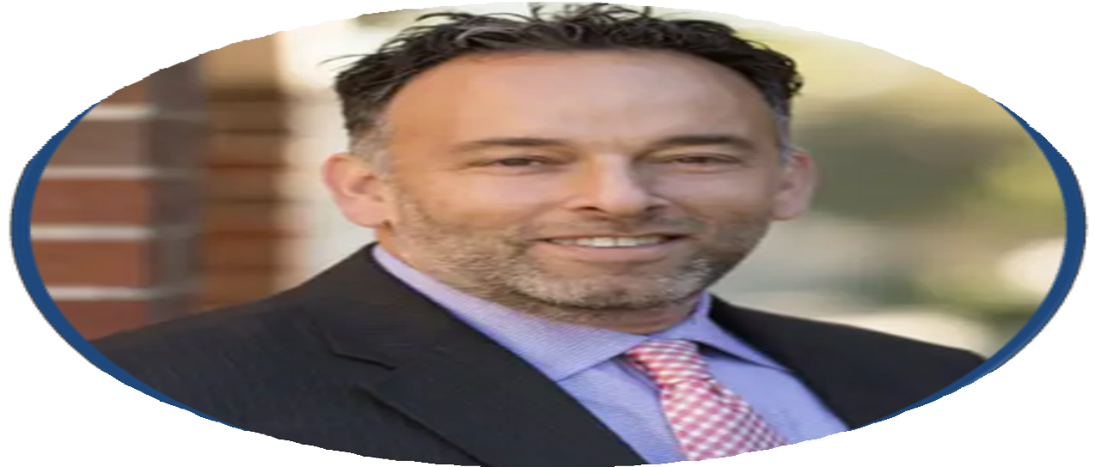


CONTACT US
PHONE NUMBER:
(469) 398-2780
EMAIL ADDRESS:
TEAM@KALISERLAW.COM
MKALISER@KALISERLAW.COM

