Slide 1




How Remote Staffing (VAs) Can Help Grow Your Real Estate
Syndication
Business
Boost Efficiency, Scale Faster, and Maximize Profits with
the right support

Slide 2





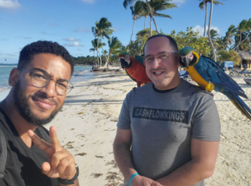
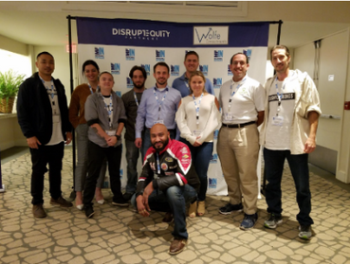
Frank Patalano started out as a school teacher with a second job in retail. As his savings grew, and after giving up on stocks, he decided to try real estate. Starting with a house or so annually, he eventually decided to take the leap to be a full-time investor. Frank is now passively or actively involved in 12 markets across the US and Caribbean. While mostly experienced in Multifamily rentals, he also has some experience in Hard Money Lending, New Construction, Commercial Rentals, and fix and flips. Currently, his businesses focus on Syndications, Virtual Assistants, and Boutique Hotels.
  Current Real Estate Holdings- 14 units in RI and NH
  JV- 47 units in RI
  JV- 30 units in WV
  General Partner- 573 units currently Ridgeline Apartments, Pocatello, ID, 100 Mary Apartment Homes, Iowa Park, TX, Apt Portfolio, Albuquerque, NM, Wando East 79 Mt. Pleasant, SC, Brigadoon Apartments, Wichita Falls, TX, Wando East 51, Mt. Pleasant, SC, Apt Portfolio, Southbridge, MA, Wellesley Place, Columbia, SC
  Limited Partner- Currently in 852 units as an LP
  Majority Owner- Bella Vida Hotel in Punta Cana
Frank Patalano
Full Time Accredited Real Estate Investor and Entrepreneur

Slide 3

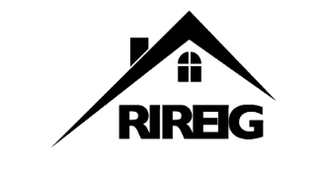






Principal-
Quahog Capital
Grand Pooh Bah-
RI Real Estate Investors Group
Co-Host-
“The CashFlow Kings” Podcast
Co-Owner-
Best Resorts Punta Cana
Co-Owner-
RealHelper.com
Co-Owner-
Gore Luxe Development
Frank Patalano
Full Time Accredited Real Estate Investor and Entrepreneur
Co-Owner-
Bella Vida Hotel- Punta Cana
Co-Founder-
PerfectBookeeping.com
“The deal of the decade happens to someone every week. It just has to happen to you once in a while.”

Slide 4


How most people that I know use VAs?
Most of the people that I know use VAs for 4 major tasks.
  Administrative Assistance
  Social Media Support
  Bookkeeping
  Cold Calling

Slide 5

Why Leverage Virtual Assistants in Real Estate Syndication?
Real Estate investing involves multiple moving parts:
Deal Sourcing, Investor Relations, Marketing, and (sometimes) property management.
A well-trained VA can help you scale without paying US prices for help.

Slide 6

Common Bottlenecks in Growing your Business
  Underwriting, Market Research and Deal Sourcing require constant attention
  Time-consuming Investor Outreach and Communication
  Administrative and compliance tasks slow down operations
  Managing multiple properties and keeping financial records up-to-date

Slide 7

How Virtual Assistants Drive Syndication Success
  Cost-Effective Support – Get certain skills at a lower cost than in-person help.
  24/7 Productivity & Faster Turnaround – With VAs across different time zones, tasks like investor inquiries, property research, and marketing could continue beyond the 9-5, accelerating deal flow and investor engagement.

Slide 8

How Virtual Assistants Drive Syndication Success
  Task Delegation & Increased Focus on Growth – Offload Administrative Tasks, CRM updates, Lead Generation, and Investor Follow-ups so you can focus on closing more deals, securing funding, and building partnerships.

Slide 9

How Virtual Assistants Drive Syndication Success
  Scalability Without High Overhead Costs – Scale your team on demand by hiring additional VAs as needed, instead of committing to expensive full-time employees. This flexibility ensures higher efficiency with lower financial risk.

Slide 10

How Virtual Assistants Drive Syndication Success
  Enhanced Investor Experience & Retention – A dedicated VA can ensure faster response times, timely follow-ups, and personalized updates for investors, leading to stronger relationships and repeat investors.

Slide 11




How Virtual Assistants Drive Syndication Success
  More Deal Flow – With VAs handling property research, outreach, and lead nurturing, syndicators can move faster on qualified opportunities, increasing their chances of closing deals.
1-800-383-2965 support@realhelper.com www.realhelper.com

Slide 12

Key Roles that a VA Can Fill in Real Estate Syndication
  Investor Relations – Manages investor communications, sends newsletters, and updates portals.
  Lead Generation – Scrapes data, identifies potential investors, and manages outreach

Slide 13

Key Roles a VA Can Fill in Real Estate Syndication
  Market Research – Conducts property and market analysis, and compile reports
  Administrative – Handles emails, calendars, contacts, and CRM updates
  Social Media – Manages accounts, creates content, and runs ads

Slide 14

Key Roles a VA Can Fill in Real Estate Syndication
  Bookkeeping - Underwrites deals, tracks financials, reconciles transactions, and prepares reports
  Property Management - Coordinates maintenance, tracks tenant inquiries, and schedules inspections

Slide 15
Real Estate Syndicators Who Leveraged VAs
Before
After
Some may struggle with investor follow-ups, are poorly organized, miss deals, or are caught up in the mundane tasks of day to day ops.
Created systems to delegate admin tasks, focus on your superpower, and increase deal flow.
Result: Increased efficiency, happier investors, and revenue growth.

Slide 16
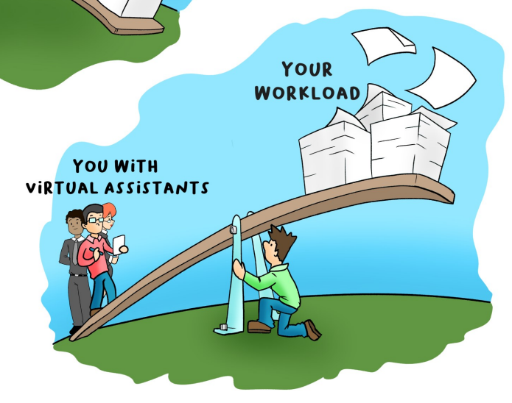
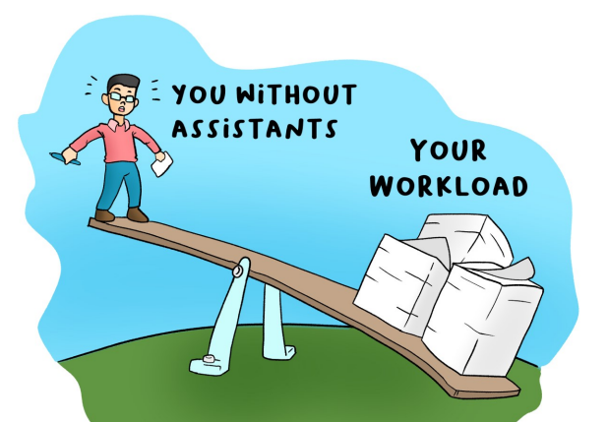
Leveraging Virtual Assistants in your business helps you
complete a disproportionate amount of tasks.

Slide 17











Hiring a VA: A Step-by-Step Guide
Define your needs:
Set a budget:
Where are you hiring from?:
Interview & test candidates:
Onboard & Delegate Tasks:
Balance cost with experience and skills.
How many hours do you need?
Identify which tasks to outsource first.
What Country?
Check skills, experience, and reliability.
Provide SOPs, tools access, and regular feedback.

Slide 18
Where do we find VAs?
Every person is unique.
Each person has a different skill set.
We tend to hire by country.
We look for places with consistent Electric, high speed Internet, a population with many English speakers and a society that values Education.
Society and Cultures do affect our search.

Slide 19





















Examples of Tools Used by the VAs
Slack
Zoom
Loom
HubSpot
Active Campaign
Dotloop
Google Calendar
Trello
Asana
ClickUp
Quickbooks
Xero
Mailchimp
Google Voice
Google Drive
Drop Box
AppFolio
Buildium
GoHighLevel
DocuSign
Gmail

Slide 20



Leverage Virtual Assistants to Grow Your Real Estate Syndication Business
VAs help syndicators scale by handling time-consuming tasks.
Hiring a VA is a cost-effective way to boost efficiency and revenue.
The right VAs + smart processes = faster growth.

Slide 21
What VAs are not?
Remote Staffing Employees are just regular people in other parts of the world.
Since 2020, many people in the United States work 100% remote as well.
They are Not Robots.
They do make Mistakes.
Life’s emergencies happen. They get sick, sometimes they move on to other things.
Paying a decent salary, offering a consistent schedule, and treating employees with respect greatly reduces turnover.

Slide 22




Frank Patalano
1-800-383-2965/‪401-996-5818 Cell
info@realhelper.com
www.realhelper.com

