Slide 1
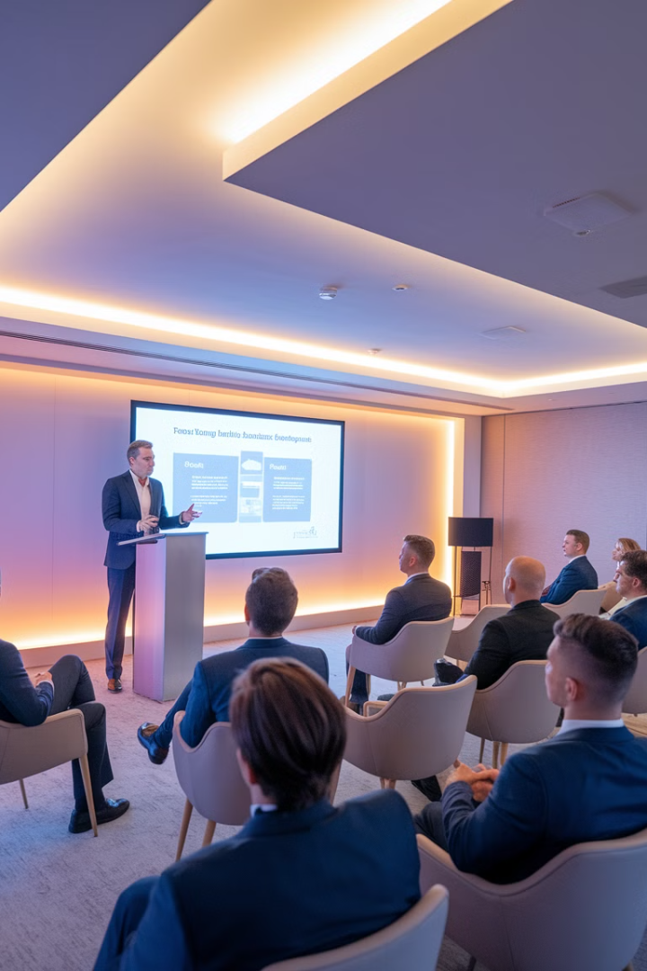

Warrior Course
Introduction

Slide 2

Goals & Outcomes
Build Technical Skills
Know What You Don’t Know
Practice, Practice, Practice!

Slide 3

Classes
3 Evening Classes
per Week
HP Calls
Q&A Calls
Zoom Speed
Networking
Miss a call? Watch the recording
Keep questions relevant to the call's topic
Classes are for Education; Homework is for Repetition & Mastery
Action Items
Add time in your calendar to work on Warrior content
each week
Add time to do recommend reading
Add the call times into your calendar
Add reminders to connect with new Warriors

Slide 4



Reading

Slide 5

Networking
Networking Calls
1
Weekly opportunities to connect with fellow Warriors
2
Zoom Speed Dating Calls
Quick connections to expand your network efficiently
Warrior Only Events
3
Exclusive gatherings for program members
4
Annual 3-Day Bootcamp
Intensive learning and
networking experience
Warrior Workshops
5
Focused skill-building
sessions
6
Warrior Meet-Ups
Casual gatherings to strengthen relationships
Action Item
Add these events into your calendar

Slide 6



Community Building
Capital Raising
2
Strategies for attracting investors
and funding
Acquisitions
Finding and securing profitable real estate deals
1
3
Asset Management
Optimizing property performance
and value
Action Item
Take notes for your strengths, weaknesses,
likes, and dislikes
Within 90 days you need to know your role

Slide 7




Framework of Success
Operating Deals
1
Managing assets for optimal returns
Finding Deals
2
Sourcing profitable opportunities
Building Capital Access
3
Developing investor relationships
Education
4
Foundation of knowledge

Slide 8
Warrior Levels
Those who make it their life and mission
1
Fully committed to success
Those who show up, watch calls, and network
2
Actively participating but not fully immersed
Those who expect results simply because they joined the Warrior Group
3
Minimal effort, unrealistic expectations

Slide 9

Final Rundown
Underwriting Course
Pitch Deck Creation
Legal Structure
Speaking to Investors
Capital Raising
Due Diligence
Finding Deals
Vendor Management
Tax Strategies
Property Management
Team Building
KPI Tracking
Risk Management
Mystery Shopping
Branding
AM for Cap-Ex
Marketing
Contracts & LLCs
CRM Management
…and so much more!

Slide 10
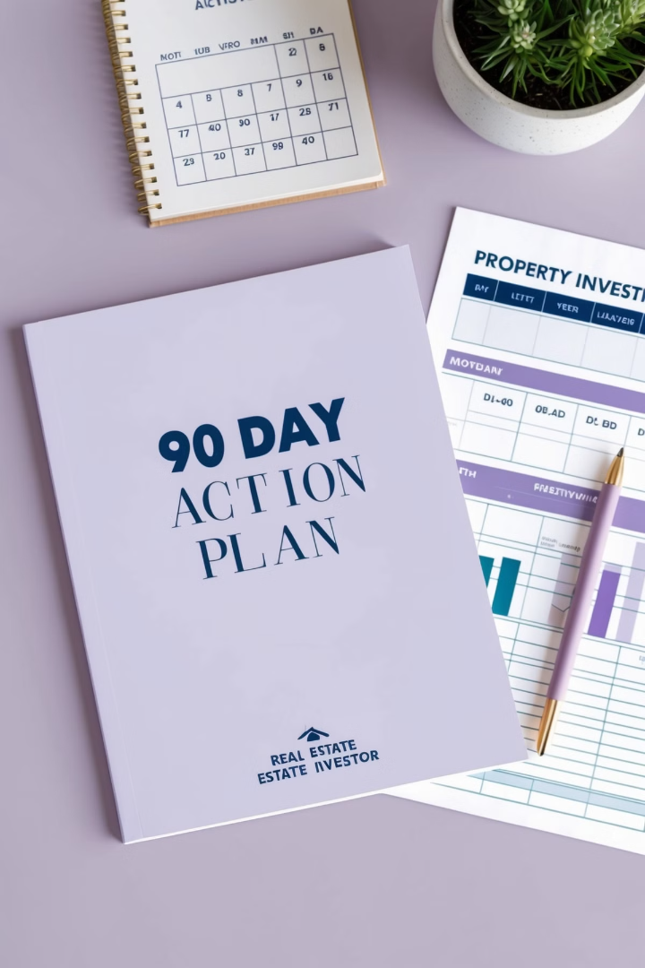
90 Day Action Plan

Slide 11



Connect with Warriors
Build Your Network
Starting immediately and throughout this process connect with as many Warriors as you can.
Success Through Connection
Our most successful Warriors (by far) are the most connected Warriors in our program.

Slide 12





Week 1 Tasks
Essential activities to complete during your first week:
Set Short Term Goals
Number of OMs to review per week
Number of brokers to call per week
Number of Warriors to meet per week
Number of deals underwritten per week
Perform Self Evaluation
Who do you know? What do you know? What do you enjoy doing? What are you well-positioned to do? What do you feel called to?
Select Your 4 Markets & pick one
Population Growth, Job Growth, Income Growth, Rent Growth, Strong Absorption Rate, Low Crime, Nearby to Businesses, Strong Renter Demand, Favorable Tax & Landlord Laws
Establish Your Investment Criteria
Vintage, # of Units, Unit Mix, Unit Size, Pricing, Value-Add Play

Slide 13
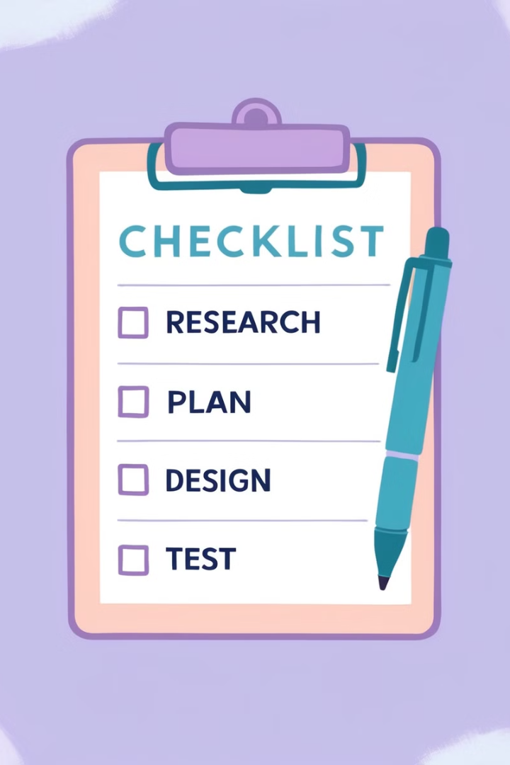




Week 1 Tasks Continued
Name Your Business & Check Domain Name
Syndication 101 Understand responsibilities of asset management, capital raising, acquisitions, limited partners, risk associated job duties, promote structure fees.
Start Process to Set Up LLC for your Branding Company
Prime Corporate Services
Get Business Specific Email Address

Slide 14
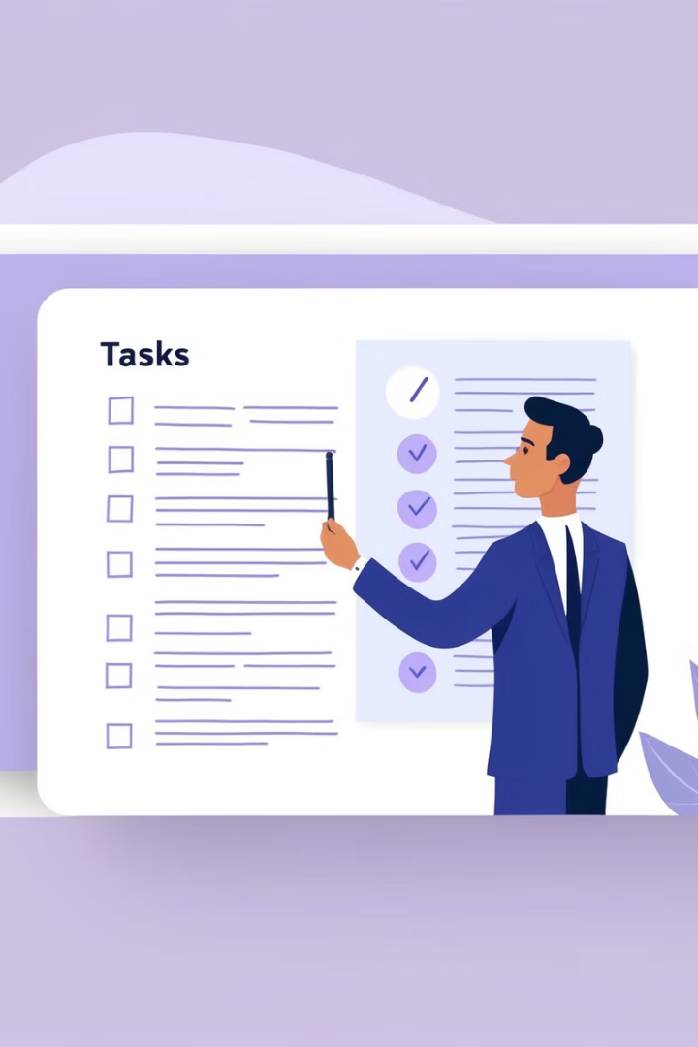





Week 2 Tasks
Visit major brokerage websites and sign CAs
Sign at least 5-10 CA's per brokerage
Newmark, Northmarq, CBRE, Colliers, JLL, MMG/GREA, TMG, Cushman & Wakefield, Marcus & Millichap, Berkadia, TKC
Download Deal Rooms
Download Deal Rooms for your top 10 deals
Create a preliminary website
Create a 1-2 page preliminary website for your investing business
Create a list of potential partners
Create a list of potential investing partners or LPs in your network
Set up a CRM & Download the MFA
Get Evolvly and the MFA

Slide 15





Week 3 Tasks
Contact potential sponsors
Contact potential sponsors (5)
Email brokers
Email the brokers for the deals you found and introduce yourself
Request debt team introductions
Ask the brokers for intros to their debt teams
Start underwriting deals
Start UW deals per your goals

Slide 16
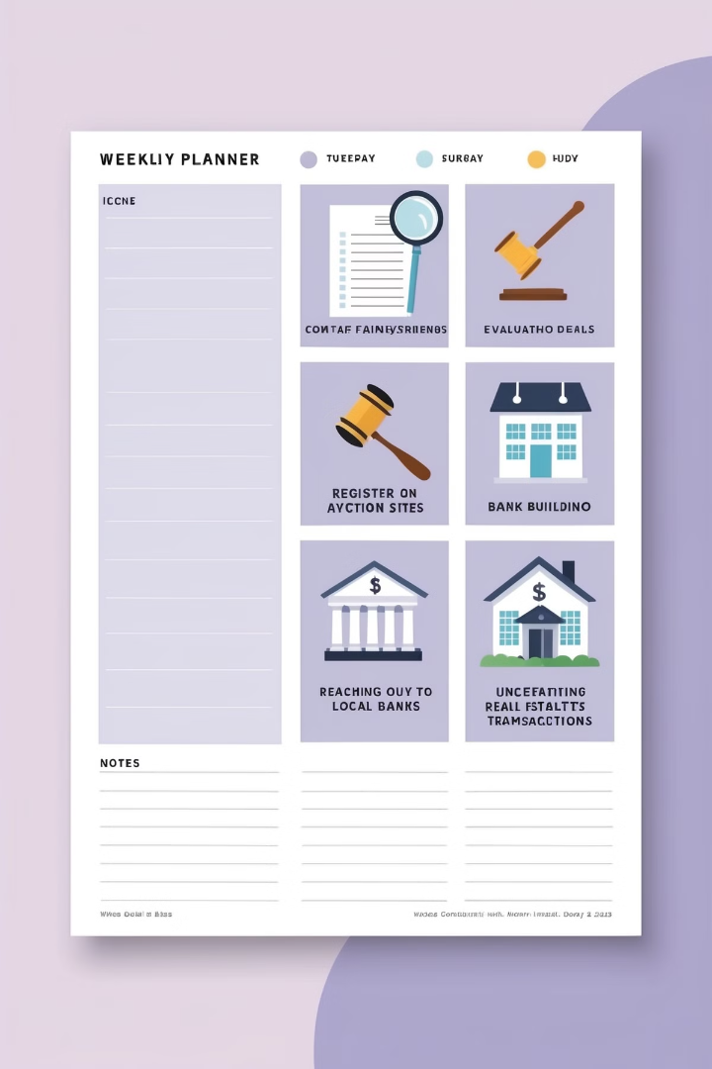





Week 4 Tasks
Contact family and friends
Contact 5 people in your list of family and friends and discuss investing.
Do Full Evaluations
Do Full Evaluations and Practice, Practice, Practice!
Register on Auction Sites
Register on Auction Sites
Contact Local Banks
Contact 2-3 Local Banks & Ask About Loan Programs and start relationships
Underwrite more deals
UW more deals

Slide 17





Week 5 Tasks
Check Brokerage Listing Sites
Check/Register on Other Brokerage Listing Sites
Contact Potential Investors
Contact 5 more potential investors and discuss
what you're doing.
Research Financing Options
Start to shop around and find best financing options
for your deal(s)
Get Property Management Referrals
Ask brokers for local PM intros and preferred
insurance vendors

Slide 18






Week 6 Tasks
Drive Your Target Market
If your target market is your backyard drive areas for
a full day and look for run-down properties.
Evaluate Properties
Evaluate 5 more properties
Build Investor Relationships
Contact 5 more potential investors and build relationships
Connect with Residential Broker
Contact a residential broker and start relationship in
case they come across a multifamily property
Find Syndication Attorney
Start a relationship with a syndication attorney like Merril Kaiser

Slide 19






Week 7 Tasks
Evaluate More Deals
Evaluate 5 more deals
Talk to Potential Investors
Talk to 5 more potential investors to invest in your deals
Research Code Violations
See if code violations or evictions might be an opportunity
for deals
Connect with Diverse Lenders
Reach out to four more different types of lenders, Local,
Bridge, Agency and Hard money
Start Investor Communications
Start drafting content for their investors and sending
content out via email using LCTA content as inspiration

Slide 20
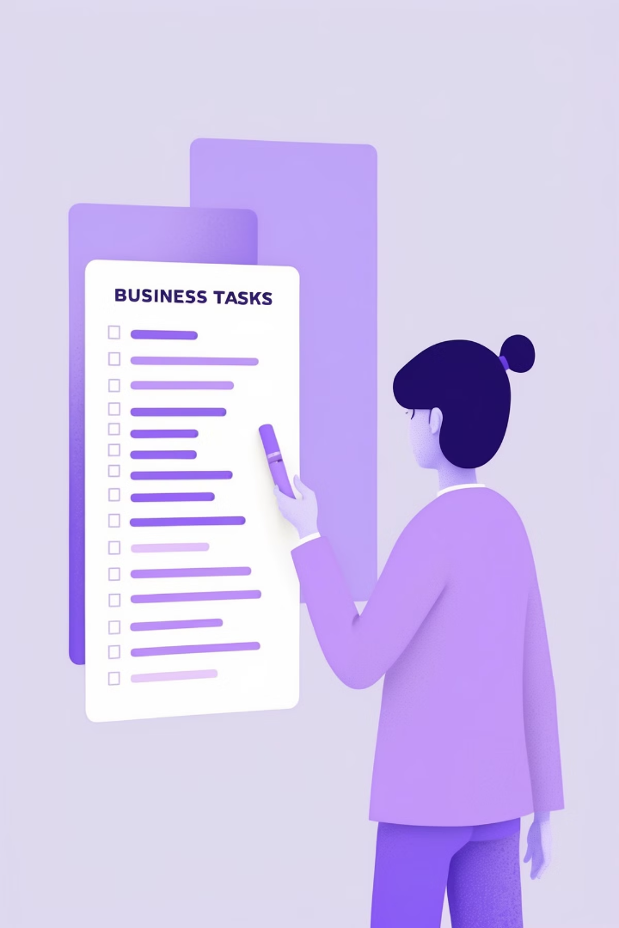




Week 8 Tasks
Enhance website
Enhance your business website to include the members of
your team you've aligned with.
Evaluate deals
Evaluate 5 more deals
Talk to investors
Talk to five more potential investors
Make an offer
Make an offer on a property with LOI or Sales Contract

Slide 21







Week 9 Tasks
Introduce deals to sponsor
Introduce deals to sponsor and discuss submitting an LOI
Negotiate with seller
Negotiate Terms With Seller
Research financing
Start looking to find best financing options for your deal
Send teasers
Send teaser to potential investors if syndicating
Insurance quote
Confirm insurance soft quote
PM study
Conduct PM feasibility study

Slide 22





Week 10 Tasks
Come to terms with seller
Settle on final LOI
Send LOI to attorney
Have them prepare purchase and sale agreement
Prepare for due diligence
Make inspection preparations
Get syndication paperwork ready
Prepare necessary documentation

Slide 23
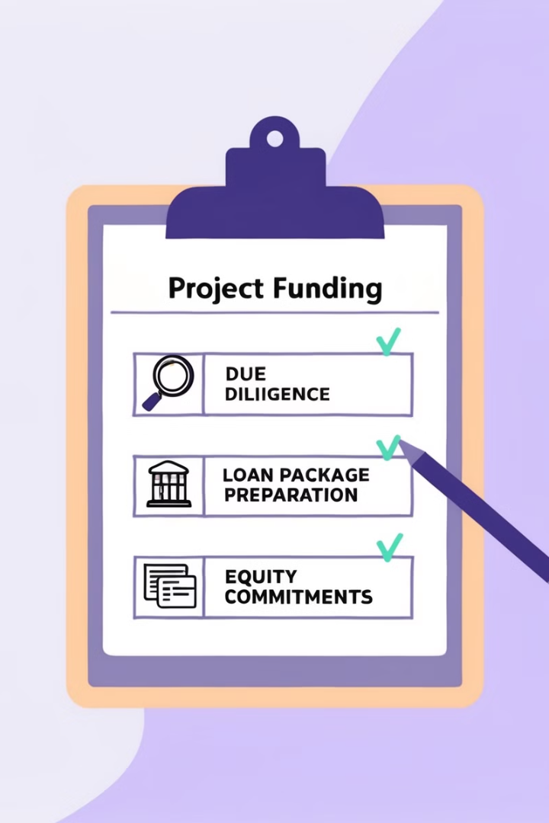



Week 11 Tasks
Due Diligence
Do all of your due diligence over the next 30 days
Loan Package
Prepare loan package for your lender
Equity Commitments
Work on firming up commitments for all equity from
investors/partners

Slide 24






Week 12 Tasks
Continue Due Diligence
Keep going on due diligence to prepare to close in 30 days.
Look under every rock
Secure Investor Equity
Firm up equity from your investors/private lenders
Submit Lender Documentation
Provide all required documentation to your lender
Prepare for Closing
Prepare to Close in 30-45 days!!
Form Partnership Entities
Set up Partnership LLC
Form Property Entities
Set up Property LLC
Establish Banking
Open Partnership and Property Bank Accounts

Slide 25



Q&A Session
Content Schedule
Call Recordings
Recordings of all scheduled calls and virtual meetings will be found in your online course portal
Access the full program calendar with upcoming classes and events & meeting
Links.
https://www.addevent.com/calendar/oK860101

