Slide 1

Weighted Return
CAP Rate and Lending Rate Effects on Returns
Presented by: Chris Wooten realchriswooten@FB, Insta, LinkedIn
$250+M AUM

Slide 2






Real Chris Wooten
Retired Marine Corps LDO Officer
25+ years asset management & constant process improvement.
Forced to learn submarket analysis due to Marine Corps moves ever 2-3 years.
Started remote flipping with OPM while active duty in 2015, flipped 27 houses in two years.
Purchased first MFR Jan 2016, and quickly learned ropes of self-directed IRA investing.
GP, KP +3,500-units

Slide 3
Terms
Capitalization Rate
Lending Rate
Standard
aka CAP Rate
An investing metric used to measure the rate of return on the capital in an investment.
aka Debt Interest Rate
This is the interest the lender is charging on the debt.
Valuation: $5M
NOI: $250k
CAP Rate: 5%
Amortization over 30-years.

Slide 4
Challenges
Challenge 1
Challenge 2
Challenge 3
Fed Rate on the Rise
The Fed Borrowing Rate is on a rise causing lending rates to increase to levels not seen in years.
CAP Rates at Low’s
The demand for Multifamily property has pressed the CAP rate to all time lows.
CAP and Lending Rate are INVERTED
These two metrics have not been inverted in 30 years.

Slide 5
Unlevered or ALL CASH
Model
Valuation $ 5,000,000
Capital $ 5,000,000
CAP Rate 5.00%
NOI $ 250,000
COC 5.00%
NOI / Capital = COC

Slide 6
Higher Returns Through Leverage
 | 80% LTV | Yr1 | Yr2 | Yr3 | Yr4 | Yr5
Debt Payment | 3% Interest | $118,858 | $235,176 | $348,876 | $459,880 | $568,104
Post Debt Cash |  | $131,142 | $264,824 | $401,124 | $540,120 | $681,896
COC Return | YOY | 13.11% | 13.24% | 13.37% | 13.50% | 13.64%

Slide 7
When CAP = Interest
 | 80% LTV | Yr1 | Yr2 | Yr3 | Yr4 | Yr5
Debt Payment | 5% Interest | $198,660 | $394,300 | $586,767 | $775,897 | $961,521
Post Debt Cash |  | $51,340 | $105,700 | $163,233 | $224,103 | $288,479
COC Return | YOY | 5.13% | 5.29% | 5.44% | 5.60% | 5.77%

Slide 8
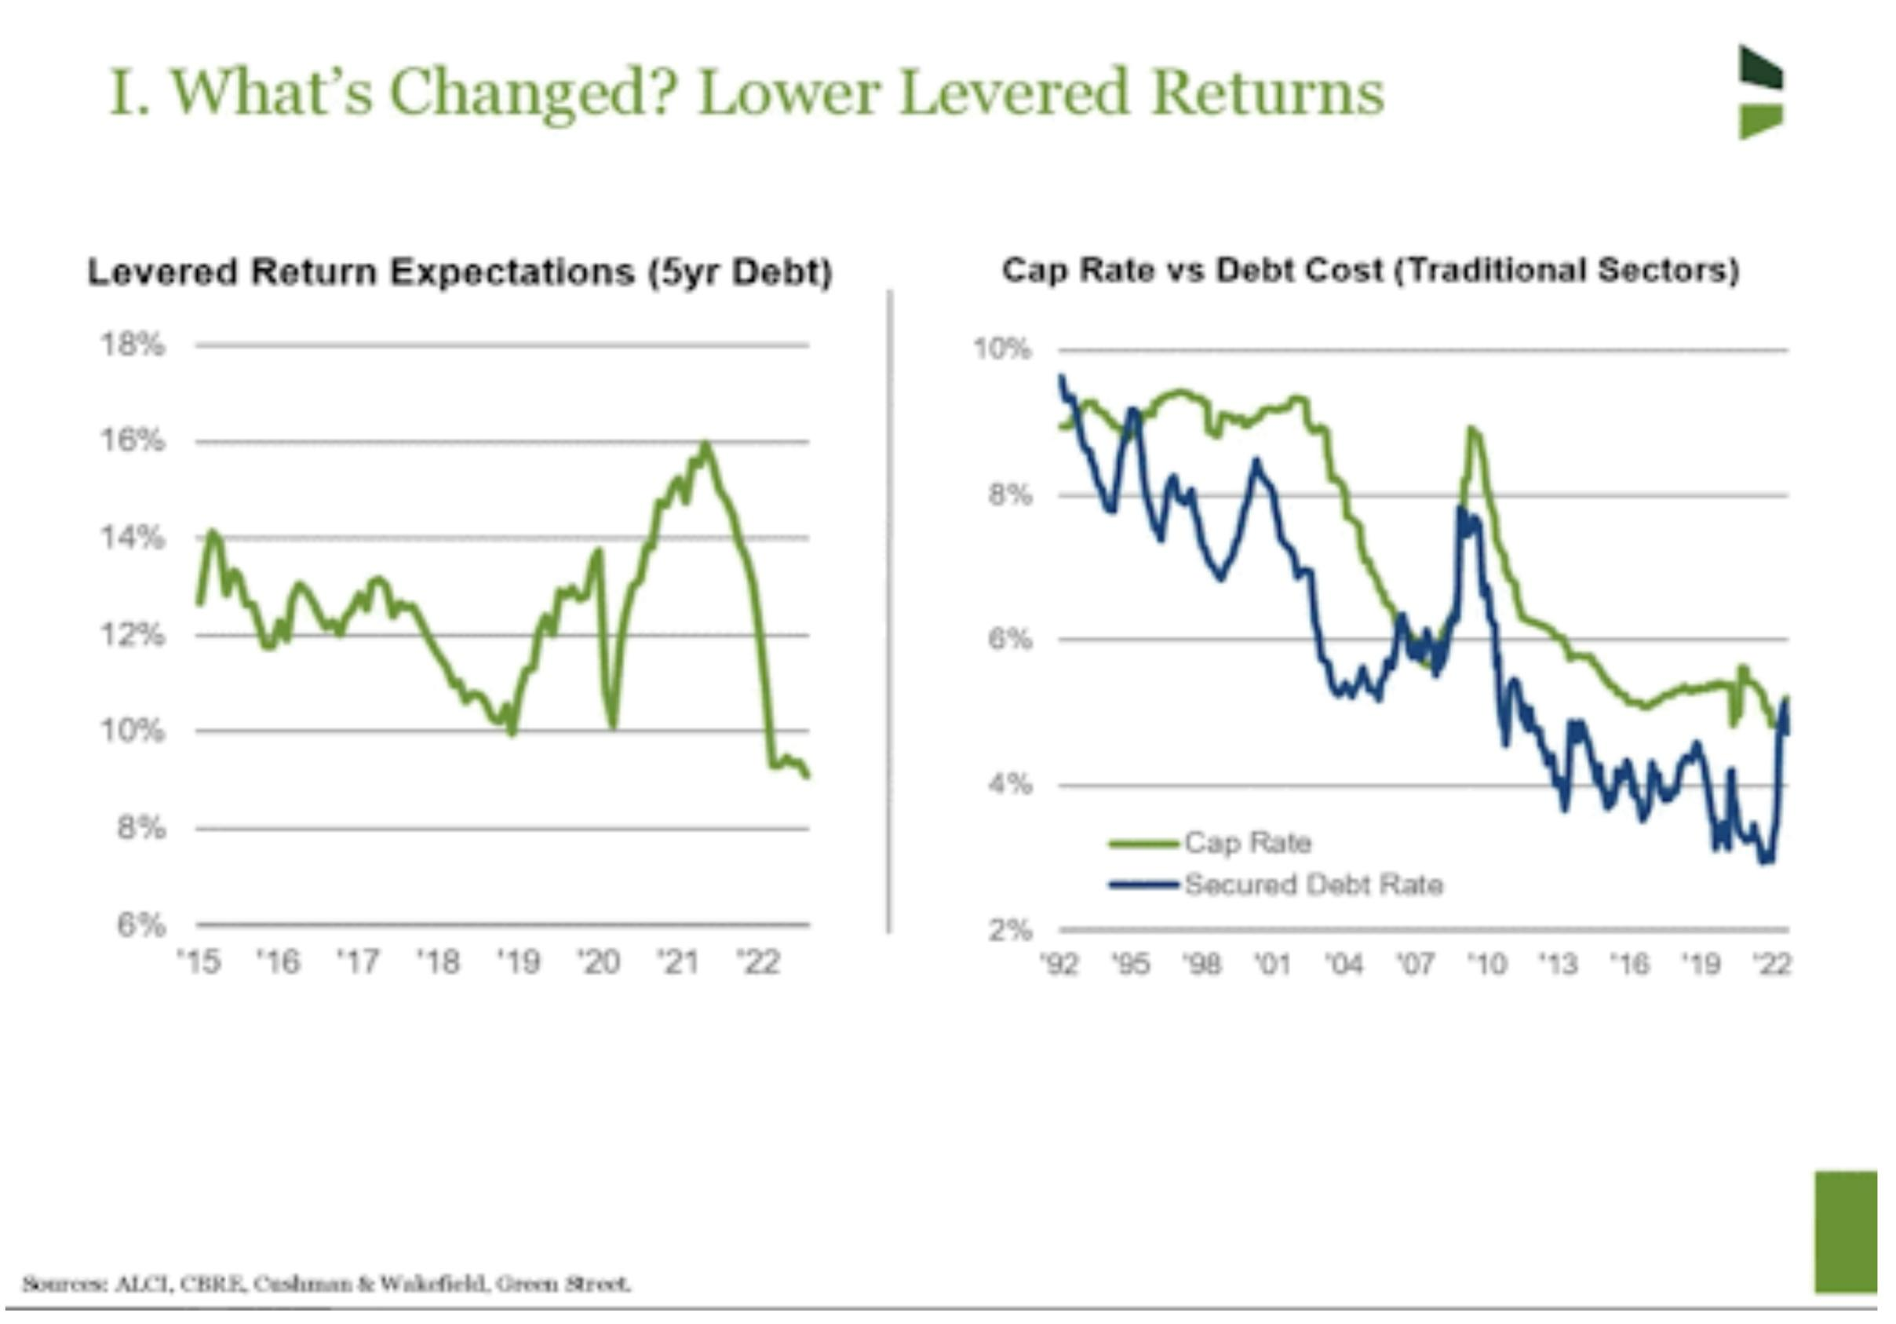
+30 years since the last inversion

Slide 9
5% CAP rate against a 6% Interest rate
 | 80% LTV | Yr1 | Yr2 | Yr3 | Yr4 | Yr5
Debt Payment | 6% Interest | $238,664 | $474,298 | $706,716 | $935,718 | $1,161,096
Post Debt Cash |  | $11,336 | $25,702 | $43,284 | $64,282 | $88,904
COC Return | YOY | 1.13% | 1.29% | 1.44% | 1.61% | 1.78%

Slide 10
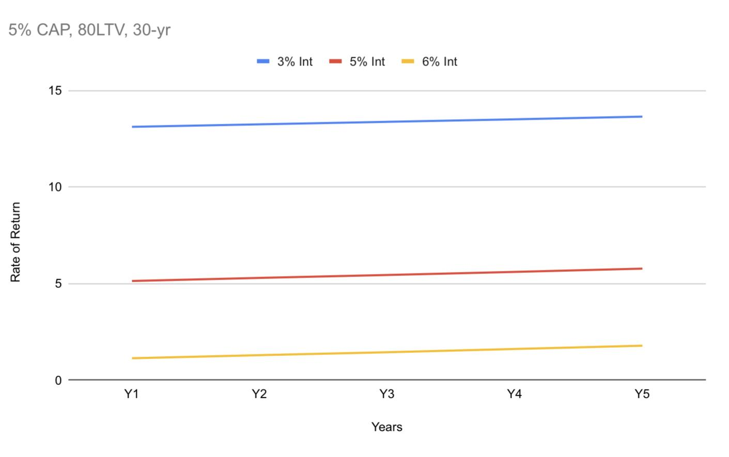
Notice the Pattern?

Slide 11
Weighted Return
(CAP Rate - Interest Rate) *
(Percentage of Debt / Percentage of Capital) =
Debt Multiplier

Slide 12
Conclusions
A CAP Rate lower than interest rate is a negative multiplier of return.
% of debt / % of capital = return multiplier.
(5-6) * (80/20) = -1 * 4 = -4 starting return
(5-6) * (70/30) = -1 * 2.3 = -2.3 starting return
Lower debt can ease negative starting return.

